Slide 1
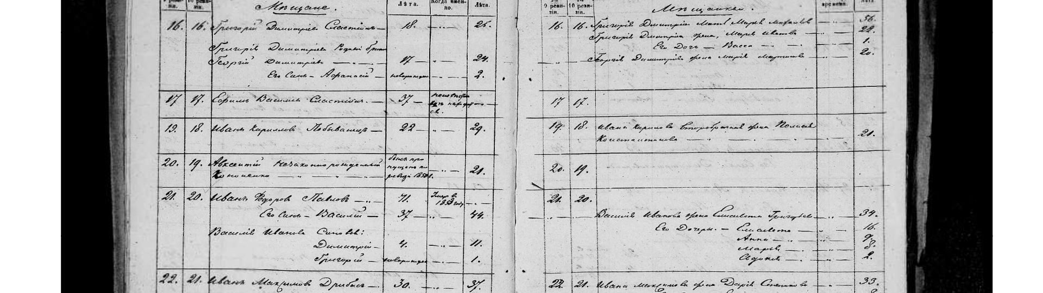
Ukraine SIG General Meeting 2017
Using Ukraine SIG and getting involved

Slide 2
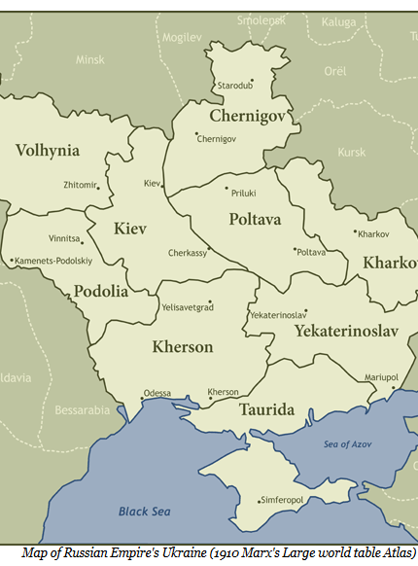
Welcome
Jewish Gen and the Special Interest Groups
Town Leader update
KehilaLinks
Joint project: Ukraine SIG and FHL
Why create a project
New Document Acquisitions

Slide 3

Avrami Groll, JewishGen Director
What is JewishGen
JewishGen Updates
Special Interest Groups

Slide 4
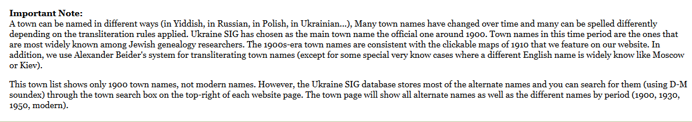
Chuck Weinstein, Towns Director

Slide 5
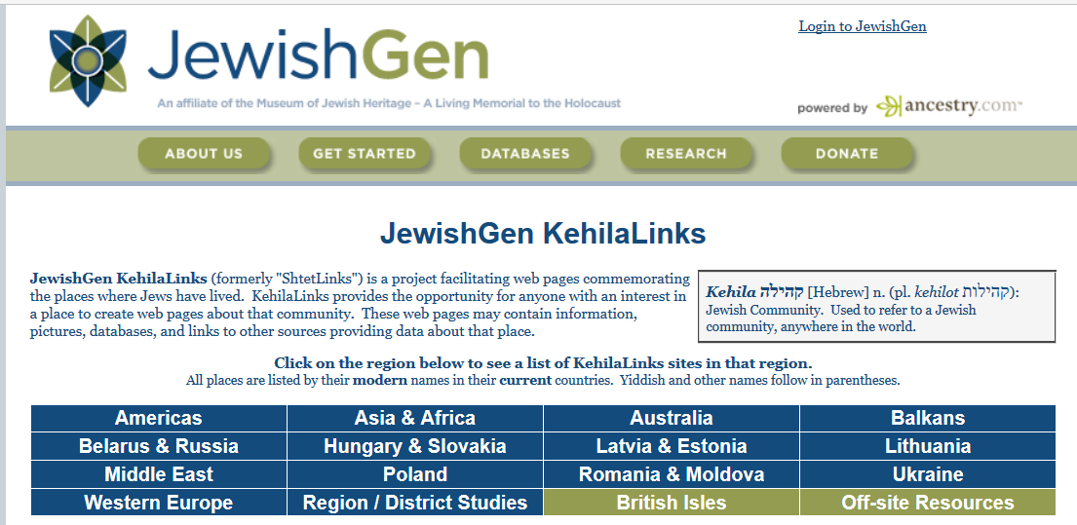
KehilaLinks: Barbara Ellman and Susana Leistner Bloch

Slide 6
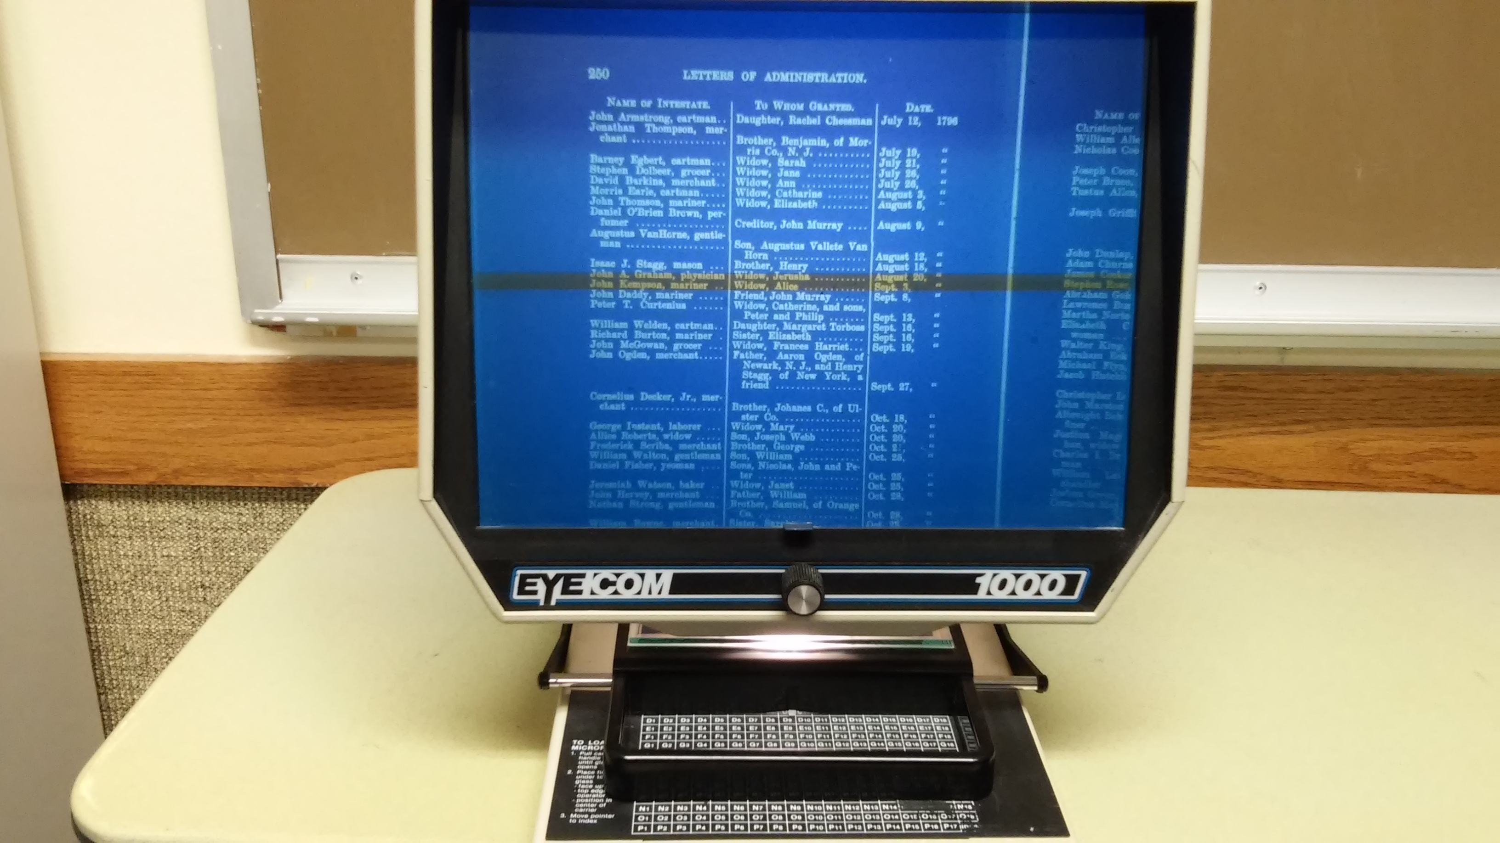
Microfilm to digital data acquisition and special collaboration
Harvey Kabaker, Project Lead

Slide 7
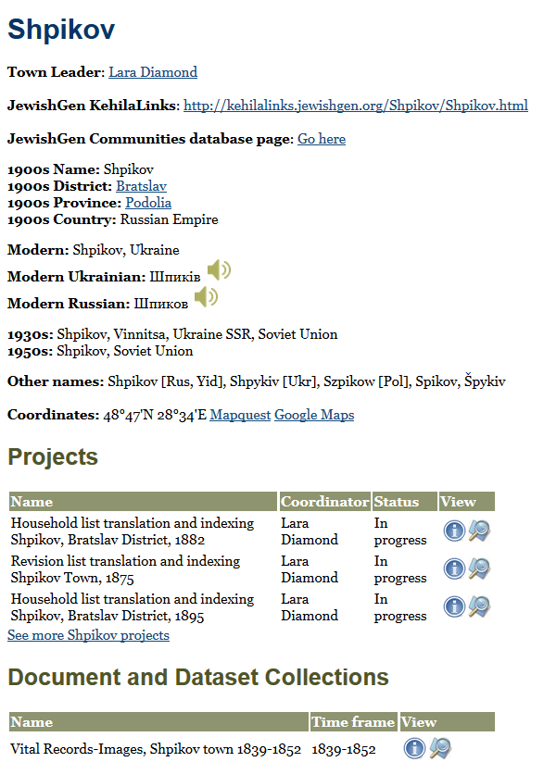
Project Leadership:
Stepping up to the
plate & taking ownership
Lara Diamond,
Shpikov Town Leader
& Ukraine SIG
Projects Director

Slide 8
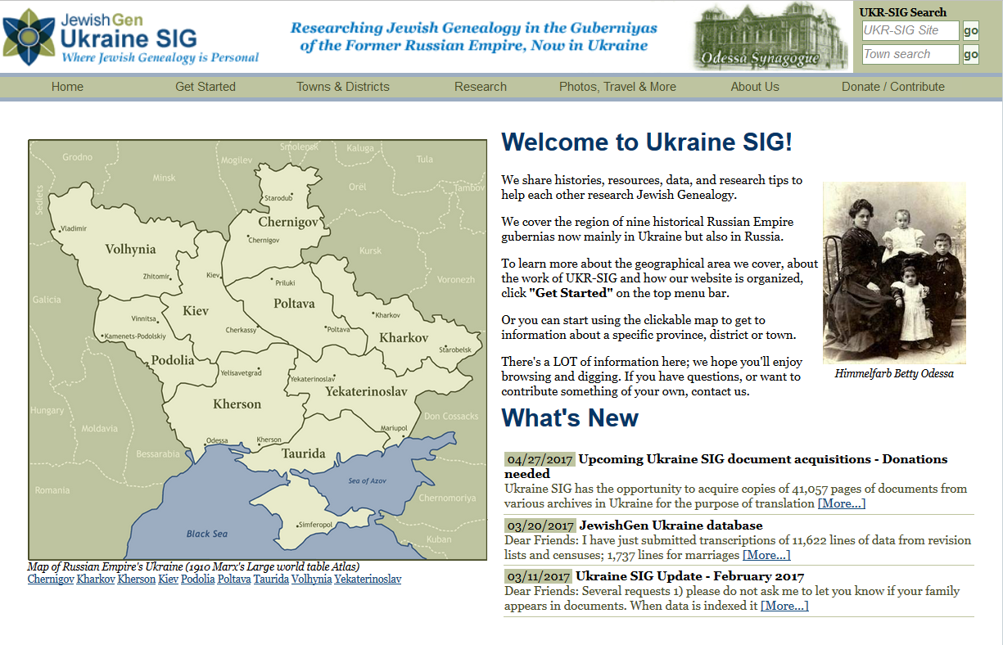
Thank You

